Slide 1
Development Version
This is the development version of the presentation. Do not post on Canvas.
Instead, export to pdf and post a link to the pdf on Canvas.
Hidden slides, comments, and slide notes will not be included in the pdf.
If you also post a recording of the lecture, then there should be no reason why the students need the notes.

Slide 2

Measures of Association
Epidemiology III
Notes:
Last week, we turned our attention more towards reviewing some of the basic tools and concepts of epidemiology, and how to apply them to solve public health issues. This week we continue that discussion.

Slide 3

“the study of the occurrence and distribution of health-related states or events in specified populations, including the study of the determinants influencing such states, and the application of this knowledge to control the health problems.”
Observe and assign values to relevant characteristics.
Look for patterns among those values.
Measurement
Source: Porta M, ed. A Dictionary of Epidemiology. Oxford University Press; 2008.
Notes:
As a reminder, epidemiology is the study of the occurrence and distribution of health-related states or events in specified populations, including the study of the determinants influencing such states, and the application of this knowledge to control the health problems.
Last week, we focused on some of the ways we can measure the occurrence of those states or events. This week, we will discuss measuring the distribution of those events.

Slide 4
Prevalence counts
Prevalence proportions
Prevalence odds
Incidence counts
Incidence proportions
Incidence odds
Incidence rates
Measurement
Source: Porta M, ed. A Dictionary of Epidemiology. Oxford University Press; 2008.
Notes:
As a quick review, some of the commonly used measures of occurrence we discussed last week include.
[Read list]

Slide 5
Terms to introduce:
Absolute differences
Relative differences
Exposed
Unexposed
Relative Risk (Risk Ratio)
Odds Ratio (Relative Odds)
Effectiveness efficacy
Mean difference
Attributable risk in exposed
Etiologic fraction
Excess fraction
Percent attributable risk
Absolute risk reduction
Number needed to treat
Population attributable risk
Point prevalence rate ratio
Multiple testing, correcting from multiple testing,. Directing for multiple testing in the context of confidence intervals
Notes:
These are not necessarily in order. I just need to make sure I hit them all.

Slide 6
Description
Causation
Prediction
Notes:
Remember, that our measurement and analysis goals can be broken down into description, prediction, and/or causally explanation of health-related phenomena in populations of people.

Slide 7
Description
Not necessarily looking for associations.
Distributions (i.e., middle, spread, shape, count, proportion) of single variables.
Examples:
How many ventilators are available in Texas?
What is the average age of people living in Florida?
How much time elapses, on average, between exposure to a pathogen and occurrence of disease symptoms.
Notes:
We said that when we describe health-related states or events, we are not necessarily looking for associations in the data between two or more variables. Sometimes, we are simply looking at the distribution of values in a single variable/measure.
And then we discussed a few examples.

Slide 8
Description
But, sometimes looking for associations.
Comparing distributions of single variables within levels of another variable.
Examples:
Are there more ventilators available in Texas or New York?
Are people older, on average, in Florida or Pennsylvania?
Is symptom onset quicker, on average, for Cholera or E. coli?
Notes:
However, there are also times when we want to compare the distribution of value in one variable within levels of another variable. Most people would consider these comparisons to be equivalent to measuring associations.

Slide 9
Prediction
Implies associations.
Notes:
You could also make the case that this starts to overlap with prediction. It sort of just depends on how the information is being used. But, when our goal is prediction, I think it is safe to say that our analyses will focus on associations. And what are associations?

Slide 10
“[An association is a] statistical dependence between two or more events, characteristics, or other variables. An association is present if the probability of occurrence of an event or characteristic, or the quantity of a variable, varies with the occurrence of one or more other events, the presence of one or more other characteristics, or the quantity of one or more other variables.”
Source: Porta, Miquel. A Dictionary of Epidemiology (pp. 8-9). Oxford University Press. Kindle Edition.
Notes:
Inherently statistical concept.

Slide 11
“[An association is a] statistical dependence between two or more events, characteristics, or other variables. An association is present if the probability of occurrence of an event or characteristic, or the quantity of a variable, varies with the occurrence of one or more other events, the presence of one or more other characteristics, or the quantity of one or more other variables.”
Outcome
Source: Porta, Miquel. A Dictionary of Epidemiology (pp. 8-9). Oxford University Press. Kindle Edition.
Notes:
Inherently statistical concept.

Slide 12
“[An association is a] statistical dependence between two or more events, characteristics, or other variables. An association is present if the probability of occurrence of an event or characteristic, or the quantity of a variable, varies with the occurrence of one or more other events, the presence of one or more other characteristics, or the quantity of one or more other variables.”
Exposure(s)
Source: Porta, Miquel. A Dictionary of Epidemiology (pp. 8-9). Oxford University Press. Kindle Edition.
Notes:
Inherently statistical concept.

Slide 13
Exposure
“﻿In epidemiology, the exposed group (or simply, the exposed) is often used to connote a group whose members have been exposed to a supposed cause of a disease or health state of interest or possess a characteristic that is a determinant of the health outcome of interest.”
Source: Porta, Miquel. A Dictionary of Epidemiology (pp. 8-9). Oxford University Press. Kindle Edition.

Slide 14
Exposure
A pathogen (e.g., HPV)
An environmental condition (e.g., lead paint)
A Behavior (e.g., regular physical activity)
A trait (e.g., APOE ε4 allele)
A social condition (e.g., discrimination)
A comorbid disease or health condition (e.g., diabetes)
Treatment or intervention (e.g., smoking cessation program)
Source: https://www.merriam-webster.com/dictionary/exposure
Notes:
In epidemiology, it is customary to refer to potential causal characteristics as exposures. Thus, exposure can refer to a behavior (e.g., chronic excessive alcohol consumption), a treatment or other intervention (e.g., participation in an Alcoholics Anonymous program), a trait (e.g., a genotype that affects the metabolism of alcohol), a social condition (e.g., neighborhood prevalence of alcohol retail outlets), or even a comorbid disease or health condition (e.g., infection with hepatitis C virus). (Modern Epi)

Slide 15

Association
$$\operatorname{Pr}\left[Y=1 | A=1\right]≠Pr⁡[Y=1|A=0]$$
Source: Hernán MA, Robins JM. Causal Inference: What If. CRC Press; 2020.
Notes:
We can write our definition of association in a slightly more mathy way like this.

Slide 16
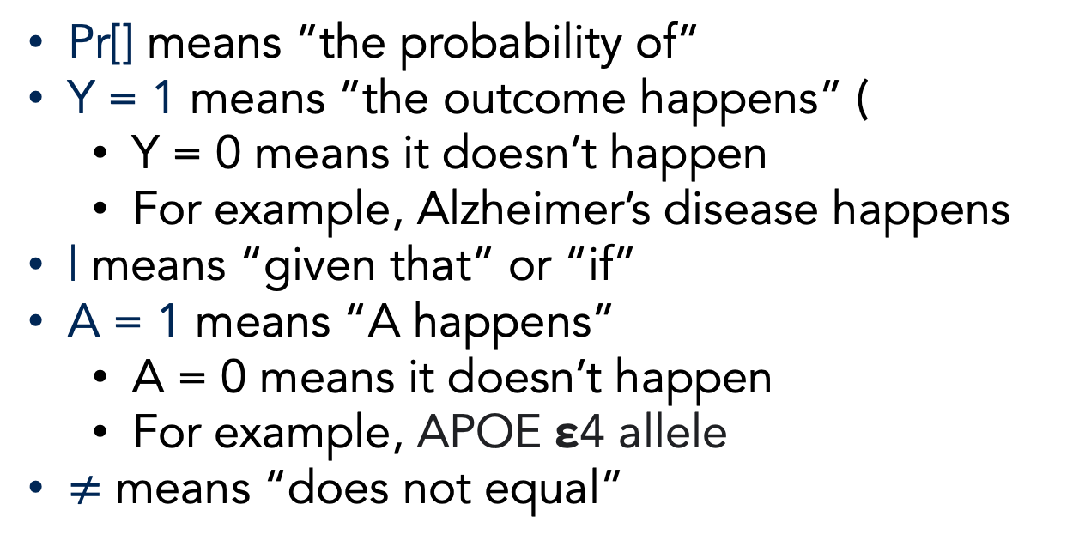
Association
$$\operatorname{Pr}\left[Y=1 | A=1\right]≠Pr⁡[Y=1|A=0]$$
Pr[] means ”the probability of”
Y = 1 means ”the outcome happens” (
Y = 0 means it doesn’t happen
For example, Alzheimer’s disease happens
| means “given that” or “if”
A = 1 means “A happens”
A = 0 means it doesn’t happen
For example, APOE ε4 allele
$≠$ means “does not equal”
Source: Hernán MA, Robins JM. Causal Inference: What If. CRC Press; 2020.
Notes:
I know equations are scary to many of us, so let’s pick this one apart a little bit.
So, how would we say this in words?

Slide 17
Association
$$\operatorname{Pr}\left[Y=1 | A=1\right]≠Pr⁡[Y=1|A=0]$$
The probability that Y equals 1 given that A equals 1 is not equal to the probability that Y equals 1 given that A equals 0.
The probability of Alzheimer’s Disease among people who carry at least one APOE ε4 allele is not equal to the probability of Alzheimer’s Disease among people who do not carry any APOE ε4 alleles
Source: Hernán MA, Robins JM. Causal Inference: What If. CRC Press; 2020.

Slide 18
Probability
How likely an event is to happen.
Notes:
And what is a probability?

Slide 19
Probability
How likely an event is to happen.
Frequency probability: The limit of the relative frequency of an event in a sequence of N random trials as N approaches infinity.
Subjective probability: A measure, ranging from 0 to 1, of the degree of belief in a hypothesis or statement.
Source: Porta M, ed. A Dictionary of Epidemiology. Oxford University Press; 2008.
Notes:
And what is a probability?

Slide 20
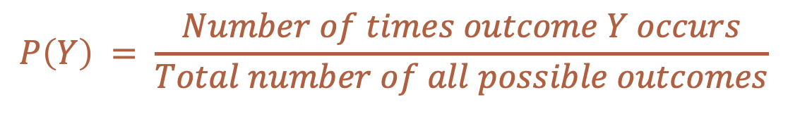
Probability
How likely an event is to happen.
Frequency probability: The limit of the relative frequency of an event in a sequence of N random trials as N approaches infinity.
Subjective probability: A measure, ranging from 0 to 1, of the degree of belief in a hypothesis or statement.
$$P\left(Y\right) = \frac{Number of times outcome Y occurs}{Total number of all possible outcomes}$$
Source: Porta M, ed. A Dictionary of Epidemiology. Oxford University Press; 2008.
Notes:
Here it is written in a more mathy way.
Notice that probability is sometimes written at Pr and sometimes written as just P.
Does this equation fit better with the frequency definition or subjective definition?
Thinking back to our Alzheimer’s example, how would we write out this equation?

Slide 21
Probability
How likely an event is to happen.
Frequency probability: The limit of the relative frequency of an event in a sequence of N random trials as N approaches infinity.
Subjective probability: A measure, ranging from 0 to 1, of the degree of belief in a hypothesis or statement.
$$P\left(Y\right) = \frac{Number of times Alzheimer^{′}s Disease occurs}{Total number of times Alzheimer^{′}s Disease could have occured}$$
Source: Porta M, ed. A Dictionary of Epidemiology. Oxford University Press; 2008.

Slide 22
Probability
How likely an event is to happen.
Frequency probability: The limit of the relative frequency of an event in a sequence of N random trials as N approaches infinity.
Subjective probability: A measure, ranging from 0 to 1, of the degree of belief in a hypothesis or statement.
$$P\left(Y\right) = \frac{Number of times outcome Y occurs}{Total number of all possible outcomes}$$
Marginal or Unconditional Probability
Source: Porta M, ed. A Dictionary of Epidemiology. Oxford University Press; 2008.
Notes:
Finally, when we just say probability in this way, we are talking about the marginal (or unconditional) probability.
If this is an UNconditional probability, then what is a conditional probability?

Slide 23
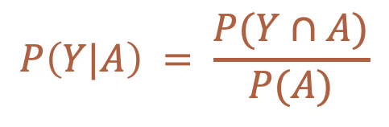
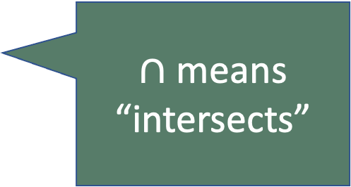
Conditional Probability
How likely an event is to happen given that something else has already happened.
$∩$ means “intersects”
$$P\left(Y|A\right) = \frac{P(Y∩A)}{P(A)}$$
Notes:
Here it is written in a more mathy way.

Slide 24
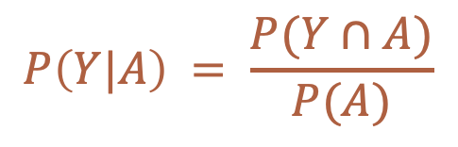



Conditional Probability
How likely an event is to happen given that something else has already happened.
$$P\left(Y|A\right) = \frac{P(Y∩A)}{P(A)}$$
$$Y$$
$$Y∩A$$
$$A$$
Notes:
Visually, it looks like this.

Slide 25
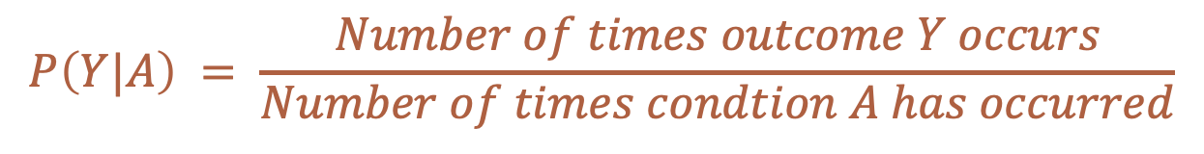
Conditional Probability
How likely an event is to happen given that something else has already happened.
$$P\left(Y|A\right) = \frac{P(Y∩A)}{P(A)}$$
$$P\left(Y|A\right) = \frac{Number of times outcome Y occurs}{Number of times condtion A has occurred}$$
Notes:
Or, we could write it out like this.

Slide 26
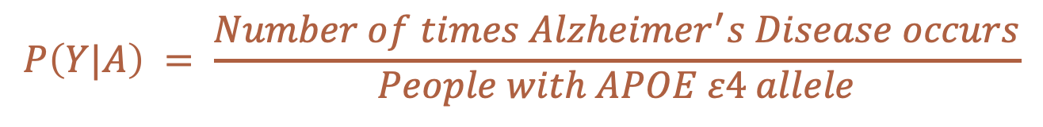
Conditional Probability
How likely an event is to happen given that something else has already happened.
$$P\left(Y|A\right) = \frac{P(Y∩A)}{P(A)}$$
$$P\left(Y|A\right) = \frac{Number of times Alzheimer^{′}s Disease occurs}{People with APOE ε4 allele}$$
Notes:
Or, we could write it out like this.

Slide 27
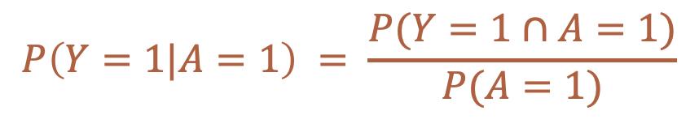
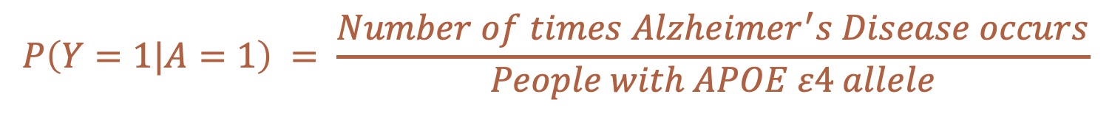
Conditional Probability
How likely an event is to happen given that something else has already happened.
$$P\left(Y=1|A=1\right) = \frac{P(Y=1∩A=1)}{P(A=1)}$$
$$P\left(Y=1|A=1\right) = \frac{Number of times Alzheimer^{′}s Disease occurs}{People with APOE ε4 allele}$$
Notes:
Finally, we could be even more explicit and write it out like this.

Slide 28
Association
$$\operatorname{Pr}\left[Y=1 | A=1\right]≠Pr⁡[Y=1|A=0]$$
Source: Hernán MA, Robins JM. Causal Inference: What If. CRC Press; 2020.
Notes:
With all of this new terminology, we can return to our definition of association.

Slide 29
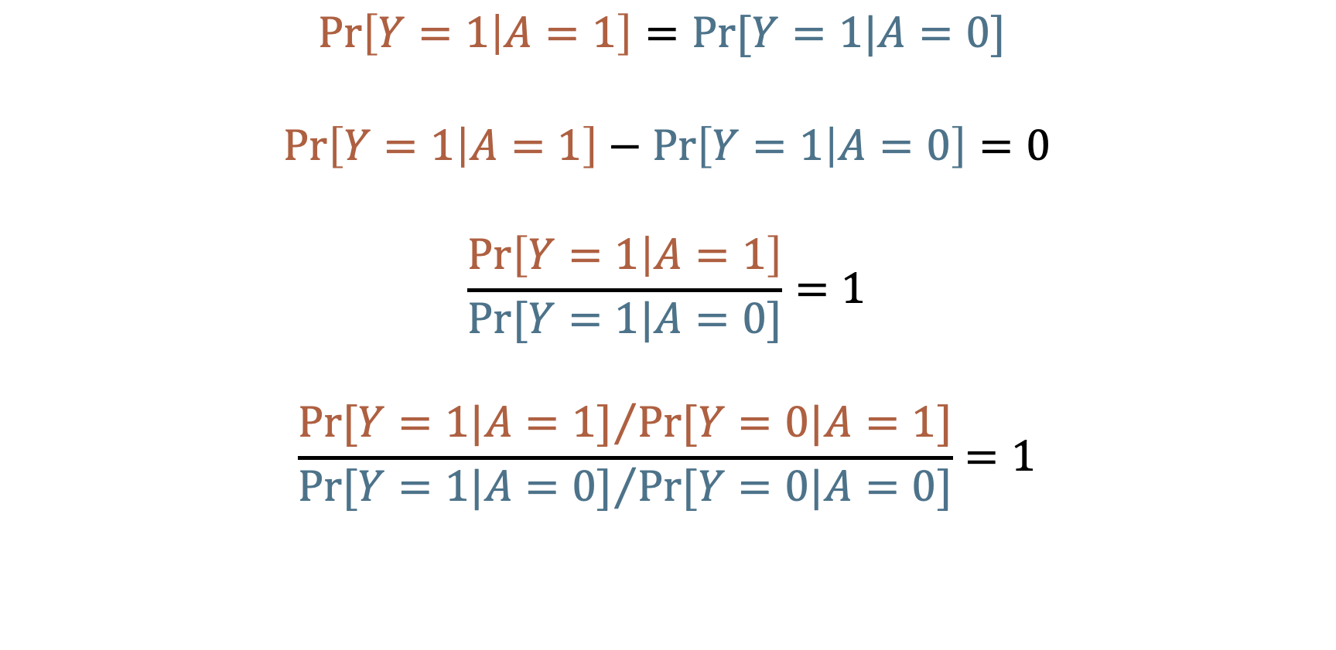
No Association (Independence)
$$\operatorname{Pr}\left[Y=1 | A=1\right]=Pr⁡[Y=1|A=0]$$
$$\operatorname{Pr}\left[Y=1 | A=1\right]−\operatorname{Pr}\left[Y=1 | A=0\right]=0$$
$$\frac{\operatorname{Pr}\left[Y=1 | A=1\right]}{Pr⁡[Y=1|A=0]}=1$$
$$\frac{{Pr⁡[Y=1|A=1]}/{Pr⁡[Y=0|A=1]}}{{Pr⁡[Y=1|A=0]}/{Pr⁡[Y=0|A=0]}}=1$$
Source: Hernán MA, Robins JM. Causal Inference: What If. CRC Press; 2020.
Notes:
And sometimes, when trying to understand what something is, it can be helpful to understand what it is not.
In this case, the opposite of an association is statistical independence.
[Read together as a class]

Slide 30
No Association (Independence)
$$\operatorname{Pr}\left[Y=1 | A=1\right]=Pr⁡[Y=1|A=0]$$
$$\operatorname{Pr}\left[Y=1 | A=1\right]−\operatorname{Pr}\left[Y=1 | A=0\right]=0$$
$$\frac{\operatorname{Pr}\left[Y=1 | A=1\right]}{Pr⁡[Y=1|A=0]}=1$$
$$\frac{{Pr⁡[Y=1|A=1]}/{Pr⁡[Y=0|A=1]}}{{Pr⁡[Y=1|A=0]}/{Pr⁡[Y=0|A=0]}}=1$$
Incidence Proportion difference association
Incidence Proportion ratio association
Incidence odds ratio association
Source: Hernán MA, Robins JM. Causal Inference: What If. CRC Press; 2020.
Notes:
These formulas represent the lack of an association on the risk difference, risk ratio, and odds ration scales respectively.
And notice what these equations are equal to when there is no association.

Slide 31
Null value
“The null value of a measure of association is the value that measure takes when there is no difference between the two groups being compared.”
Source: Westreich D. Epidemiology by Design. Oxford University Press; 2019
Notes:
These values are called Null values.

Slide 32
No Association (Independence)
$$\operatorname{Pr}\left[Y=1 | A=1\right]=Pr⁡[Y=1|A=0]$$
$$\operatorname{Pr}\left[Y=1 | A=1\right]−\operatorname{Pr}\left[Y=1 | A=0\right]=0$$
$$\frac{\operatorname{Pr}\left[Y=1 | A=1\right]}{Pr⁡[Y=1|A=0]}=1$$
$$\frac{{Pr⁡[Y=1|A=1]}/{Pr⁡[Y=0|A=1]}}{{Pr⁡[Y=1|A=0]}/{Pr⁡[Y=0|A=0]}}=1$$
Incidence Proportion difference association
Null = 0
Incidence Proportion ratio association
Null = 1
Incidence odds ratio association
Null = 1
Source: Hernán MA, Robins JM. Causal Inference: What If. CRC Press; 2020.
Notes:
These formulas represent the lack of an association on the risk difference, risk ratio, and odds ration scales respectively.

Slide 33
Risk Difference
$$\operatorname{Pr}\left[Y=1 | A=1\right]−\operatorname{Pr}\left[Y=1 | A=0\right]=…$$
$$\operatorname{Pr}\left[Y=1 | A=1\right]<\operatorname{Pr}\left[Y=1 | A=0\right]$$
$$\operatorname{Pr}\left[Y=1 | A=1\right]>\operatorname{Pr}\left[Y=1 | A=0\right]$$
Null = 0
-1, … -0.7, -0.8, -0.9
0.1, 0.2, 0.3, … 1
Association
No Association
Association

Slide 34

Risk Ratio
$$\frac{\operatorname{Pr}\left[Y=1 | A=1\right]}{Pr⁡[Y=1|A=0]}=…$$
$$\operatorname{Pr}\left[Y=1 | A=1\right]<\operatorname{Pr}\left[Y=1 | A=0\right]$$
$$\operatorname{Pr}\left[Y=1 | A=1\right]>\operatorname{Pr}\left[Y=1 | A=0\right]$$
Null = 1
0, … 0.7, 0.8, 0.9
1, 2, 3, … Inf
Association
No Association
Association

Slide 35
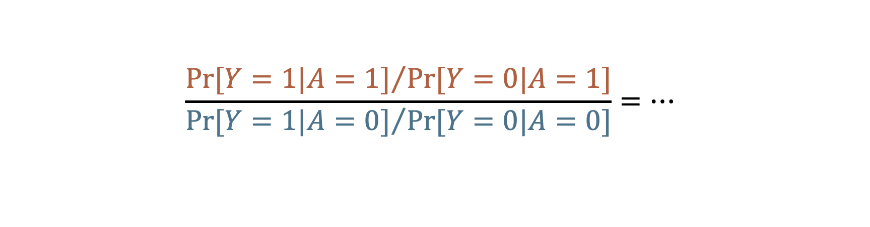
Odds Ratio
$$\frac{{Pr⁡[Y=1|A=1]}/{Pr⁡[Y=0|A=1]}}{{Pr⁡[Y=1|A=0]}/{Pr⁡[Y=0|A=0]}}=…$$
$$\operatorname{Pr}\left[Y=1 | A=1\right]<\operatorname{Pr}\left[Y=1 | A=0\right]$$
$$\operatorname{Pr}\left[Y=1 | A=1\right]>\operatorname{Pr}\left[Y=1 | A=0\right]$$
Null = 1
0, … 0.7, 0.8, 0.9
1, 2, 3, … Inf
Association
No Association
Association

Slide 36
Association
The distribution (i.e., middle, spread, shape, proportion of people in each category) of the thing we are measuring is different, on average, in two groups.
Knowing something about X tells you something about Y.
Source: Hernán MA. Causal Diagrams: Draw Your Assumptions Before Your Conclusions. edX. Accessed September 27, 2022. https://learning.edx.org/course/course-v1:HarvardX+PH559x+2T2022/home
Notes:
Association exists when the distribution of the thing we are measuring is different, on average, in two groups. Alternatively, we can say that Knowing something about X tells you something (or helps you predict) about Y.

Slide 37
Association
The distribution (i.e., middle, spread, shape, proportion of people in each category) of the thing we are measuring is different, on average, in two groups.
Knowing something about X tells you something about Y.
Source: Hernán MA. Causal Diagrams: Draw Your Assumptions Before Your Conclusions. edX. Accessed September 27, 2022. https://learning.edx.org/course/course-v1:HarvardX+PH559x+2T2022/home
Notes:
Association exists when the distribution of the thing we are measuring is different, on average, in two groups. Alternatively, we can say that Knowing something about X tells you something (or helps you predict) about Y.

Slide 38
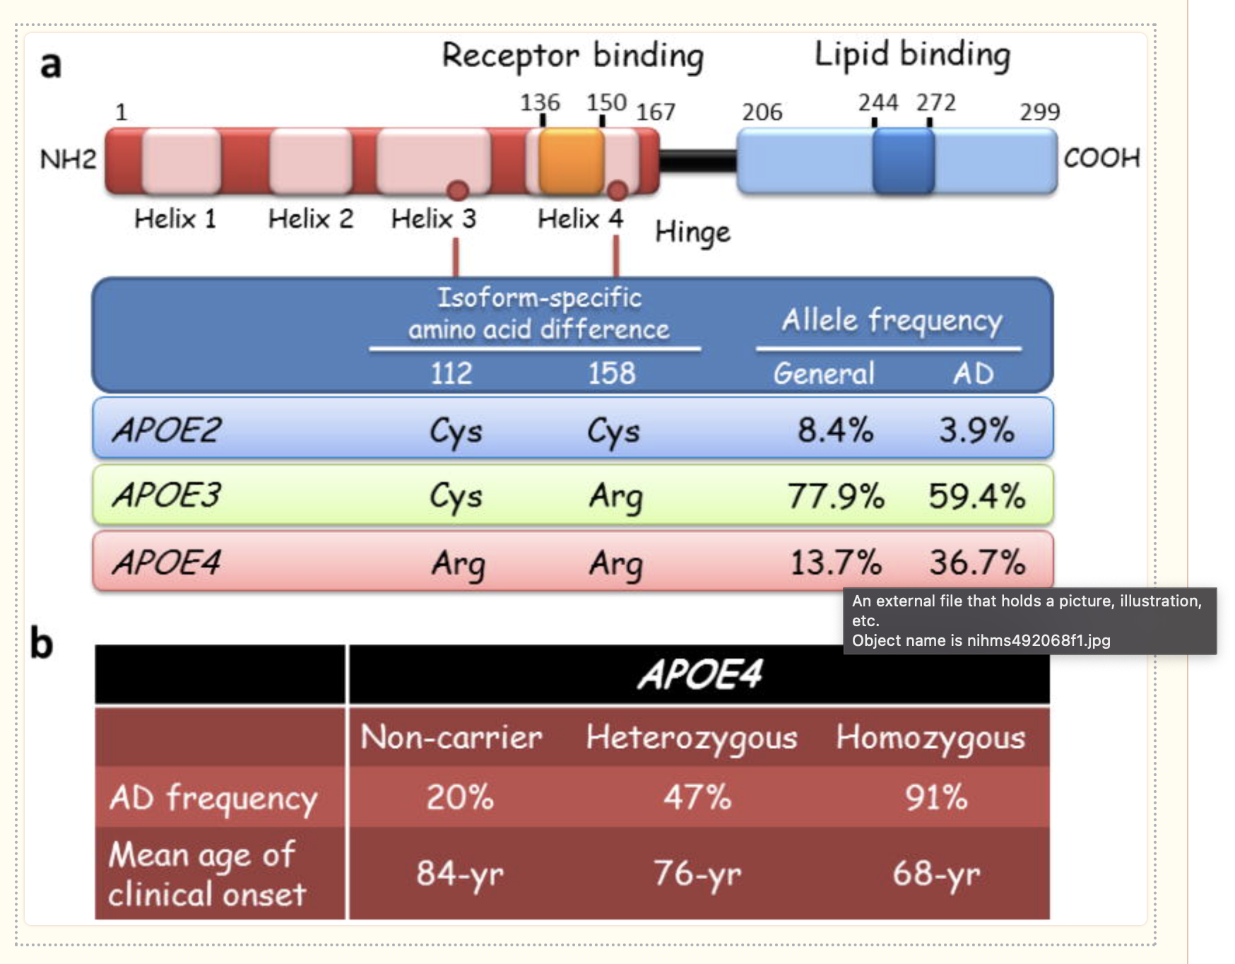

Slide 39
Prediction
Implies associations.
Examples
People of a certain race/ethnicity are more likely to get a particular cancer.
Older adults who have trouble managing finances are more likely to get dementia.
Can be useful on its own.
Often, in epidemiology, the ultimate goal is causal inference.
“the study of the occurrence and distribution of health-related states or events in specified populations, including the study of the determinants influencing such states, and the application of this knowledge to control the health problems.” (Porta 2008, page 81)
Notes:
Predictions, especially good ones, can obviously be useful on their own. We may know that people of a certain race/ethnicity are most likely to get a particular form of cancer. Knowing that may allow us to concentrate screening efforts more effectively. We may know that older adults who begin to have trouble managing their finances are more likely to develop dementia. We may be able to use that information as an early indicator of important health problems to come.
However, in epidemiology, we are very often not content with predictions alone. It is extremely common for our questions and studies to either directly ask causal questions or imply causal relationships between variables. The reason we are often more interested in causal associations than mere predictions can be found directly in our definition of epidemiology. We want to control health problems. Said another way, we want to know why ”bad” things happen so that we can stop them from happening and/or why “good” things happen so that we can make them happen more often.
This idea is simultaneously so straightforward and so complex. As we will see throughout the semester.
Notice that in the cases above these predictions may be perfectly valid, but do they get us any closer to our ultimate goal of “controlling health problems?” We can’t change anyone’s race or ethnicity, can we? Even if we could, I’m hard-pressed to think of an example of a health outcome that is caused directly by a person’s race or ethnicity. Race and ethnicity are just a proxy for the true unmeasured cause. Likewise, do you really believe that if we hired an accountant to help an older person manage their finances that they would no longer develop dementia? Of course not.

Slide 40
Measures of Association
Absolute Measures
Differences
Relative Measures
Ratios
Proportions
Odds
Rates
Proportions
Odds
Rates
Source: Szklo M, Nieto FJ. Epidemiology: Beyond the Basics. Jones & Bartlett Learning; 2019.
Notes:
We gather these measurements…

Slide 41
Measures of Association
“Measures based on absolute differences are often preferred when public health or preventive activities are evaluated, as their main goal is often an absolute reduction in the risk of an undesirable outcome.”
Absolute Measures
Differences
Relative Measures
Ratios
Proportions
Odds
Rates
Proportions
Odds
Rates
Source: Szklo M, Nieto FJ. Epidemiology: Beyond the Basics. Jones & Bartlett Learning; 2019.

Slide 42
Measures of Association
“In contrast, etiologic studies that are searching disease determinants (causes) usually rely on relative differences in the occurrence of discrete outcomes, with the possible exception of instances in which the outcome of interest is continuous; in that situation, the assessment of mean absolute differences between exposed and unexposed individuals is also a frequently used method for evaluating an association.”
Absolute Measures
Differences
Relative Measures
Ratios
Proportions
Odds
Rates
Proportions
Odds
Rates
Source: Szklo M, Nieto FJ. Epidemiology: Beyond the Basics. Jones & Bartlett Learning; 2019.
Notes:
We will look at how to calculate some of the most commonly used of these next.

Slide 43
Terminology Recap
Our Term | Definition | Equation
Marginal Probability | Frequency probability: The limit of the relative frequency of an event in a sequence of N random trials as N approaches infinity. Subjective probability: A measure, ranging from 0 to 1, of the degree of belief in a hypothesis or statement.
Conditional Probability
Null Value
Statistical Independence
Association

Slide 44
Terminology Recap
Our Term | Definition | Other Terms
Incidence proportion difference |  | Risk difference
Incidence proportion ratio |  | Risk ratio
Incidence odds ratio |  | Odds ratio

Slide 45
Break
Leaving conceptual stuff and starting to discuss how to calculate measures of association.
Notes:
So, how do we calculate these measures of association?

Slide 46
2x2 Contingency Table (Crosstab)
 | Outcome + | Outcome -
Exposure + | a | b
Exposure - | c | d
This order is important!!
Notes:
Many of the contrast measures in this chapter (risk differences, risk ratios, odds ratios, and others) will rely on explanations and illustrations from 2 × 2 tables—a central tool in the teaching of epidemiologic methods.
Westreich, Daniel. Epidemiology by Design (p. 28). Oxford University Press. Kindle Edition.

Slide 47
Person
01
02
03
04
05
06
07
08
09
10
-01
00
01
02
03
04
05
06
07
08
09
10
11
12
Pre-Follow-Up
Diseased
Month Follow-up
At Risk
Deceased
Source: Lash TL, VanderWeel TJ, Haneuse S, Rothman KJ. Modern Epidemiology. fourth. Wolters Kluwer; 2021.
Notes:
Here is our graphic from last week. So, if we came along and did a study of this group of people in month 2, the prevalence of disease would equal the number of people with disease divided by the number of people in the sample. In this case, that would be 2 people (p1 and p2) divided by 10.

Slide 48
Person
01
02
03
04
05
06
Exposed
07
08
09
10
-01
00
01
02
03
04
05
06
07
08
09
10
11
12
Pre-Follow-Up
Diseased
Month Follow-up
At Risk
Deceased
Source: Lash TL, VanderWeel TJ, Haneuse S, Rothman KJ. Modern Epidemiology. fourth. Wolters Kluwer; 2021.
Notes:
One little tweak -- exposed

Slide 49
Person
01
02
03
04
 | Disease + | Disease -
Exposure + | 3 | ?
Exposure - | ? | ?
05
06
07
08
09
10
-01
00
01
02
03
04
05
06
07
08
09
10
11
12
Pre-Follow-Up
Diseased
Month Follow-up
At Risk
Deceased

Slide 50
Person
01
02
03
04
 | Disease + | Disease -
Exposure + | 3 | 2
Exposure - | 3 | 2
05
06
07
08
09
10
-01
00
01
02
03
04
05
06
07
08
09
10
11
12
Pre-Follow-Up
Diseased
Month Follow-up
At Risk
Deceased

Slide 51
2x2 Contingency Table (Crosstab)
 | Outcome + | Outcome - | Row Total
Exposure + | a | b | a+b
Exposure - | c | d | c+d
Column Total | a+c | a+c | a+b+c+d
Notes:
Once we fill in this table, we can easily calculate many measures of interest in epidemiology.

Slide 52
2x2 Contingency Table (Crosstab)
 | Outcome + | Outcome - | Row Total
Exposure + | a | b | a+b
Exposure - | c | d | c+d
Column Total | a+c | a+c | a+b+c+d
Table Margins
Marginal Totals

Slide 53
2x2 Contingency Table (Crosstab)
 | Outcome + | Outcome - | Row Total
Exposure + | 3 | 2 | 5
Exposure - | 3 | 2 | ?
Column Total | ? | ? | ?

Slide 54
2x2 Contingency Table (Crosstab)
 | Outcome + | Outcome - | Row Total
Exposure + | 3 | 2 | 5
Exposure - | 3 | 2 | 5
Column Total | 6 | 4 | 10

Slide 55

Source: https://www.r-project.org/logo/
Notes:
How can we build a 2x2 table in R?

Slide 56
Incidence Proportion
The proportion of the population who experiences a new occurrence of the condition of interest among those in the population who are at risk of experiencing a new occurrence the condition of interest during a given time frame.
Like all proportions, falls between 0 and 1.
Source: Westreich D. Epidemiology by Design. Oxford University Press; 2019
Notes:
Remember that…

Slide 57
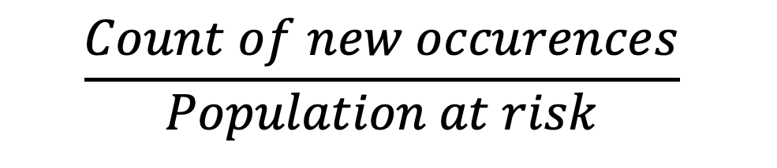


Person
Incidence Proportion
01
02
$$\frac{Count of new occurences}{Population at risk}$$
03
04
=
05
06
$$\frac{5}{9}$$
07
08
=
09
$$0.56 or 56\%$$
10
-01
00
01
02
03
04
05
06
07
08
09
10
11
12
Pre-Follow-Up
Diseased
Month Follow-up
At Risk
Deceased

Slide 58
Person
01
02
03
04
05
06
Exposed
07
08
09
10
-01
00
01
02
03
04
05
06
07
08
09
10
11
12
Pre-Follow-Up
Diseased
Month Follow-up
At Risk
Deceased
Source: Lash TL, VanderWeel TJ, Haneuse S, Rothman KJ. Modern Epidemiology. fourth. Wolters Kluwer; 2021.
Notes:
When we have two groups – e.g., exposed and unexposed – one way we can contrast outcomes in those groups is by calculating the ratio of the incidence prevalence in the exposed to the incidence prevalence in the unexposed.

Slide 59
Incidence Proportion Ratio
More commonly called
Relative risk
Risk ratio
Notes:
I like incidence proportion ratio because it is unambiguous and consistent with the previous terminology we have been using.

Slide 60
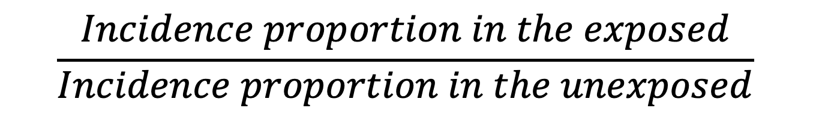
Incidence Proportion Ratio
$$\frac{Incidence proportion in the exposed}{Incidence proportion in the unexposed}$$
Notes:
We can write the information from the previous slide in a slightly more mathy way like this.

Slide 61
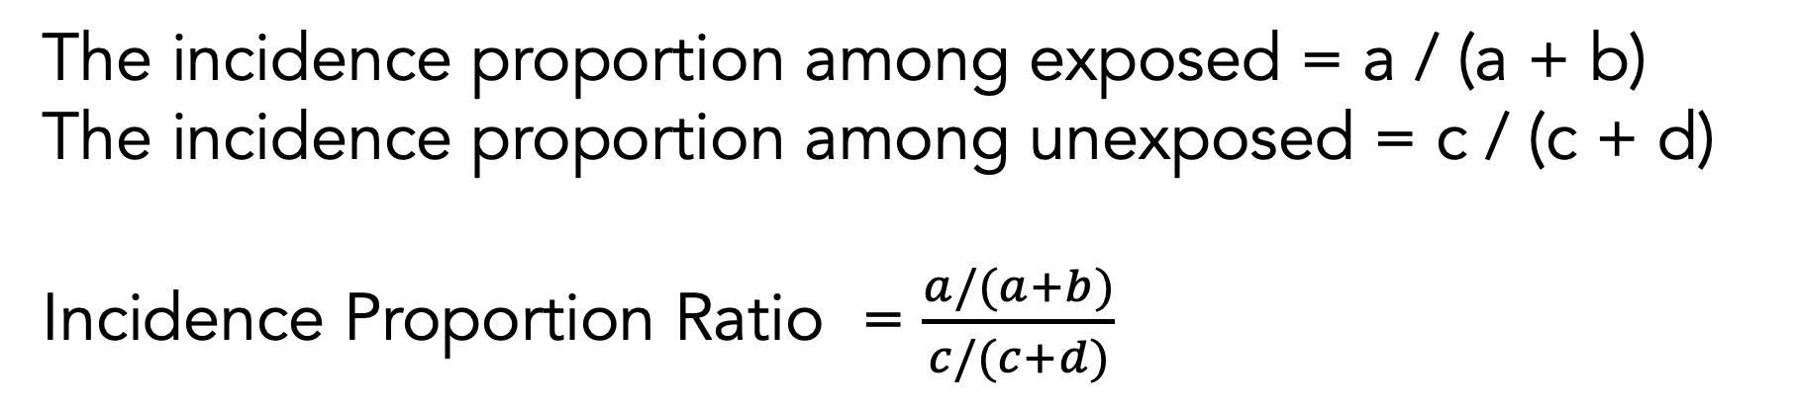
Incidence Proportion Ratio
 | Outcome + | Outcome - | Row Total
Exposure + | a | b | a+b
Exposure - | c | d | c+d
Column Total | a+c | a+c | a+b+c+d
The incidence proportion among exposed = a / (a + b)
The incidence proportion among unexposed = c / (c + d)
Incidence Proportion Ratio = $\frac{a/(a+b)}{c/(c+d)}$

Slide 62
Person
01
02
03
04
 | Disease + | Disease -
Exposure + | 3 | 2
Exposure - | 2 | 2
05
06
07
08
09
10
-01
00
01
02
03
04
05
06
07
08
09
10
11
12
Pre-Follow-Up
Diseased
Month Follow-up
At Risk
Deceased

Slide 63
Source: https://www.r-project.org/logo/

Slide 64
Person
Incidence Proportion Ratio
01
02
Among the members of our population, those who were exposed had 1.2 times the incidence of disease compared to those who were not exposed over the 12 months of follow-up period.
03
04
05
06
07
08
09
10
-01
00
01
02
03
04
05
06
07
08
09
10
11
12
Pre-Follow-Up
Diseased
Month Follow-up
At Risk
Deceased

Slide 65
Incidence Proportion Difference
More commonly called
Risk difference
Notes:
I like incidence proportion ratio because it is unambiguous and consistent with the previous terminology we have been using.

Slide 66
Incidence Proportion Difference
$$Incidence proportion in the exposed −Incidence proportion in the unexposed$$
Notes:
We can write the information from the previous slide in a slightly more mathy way like this.

Slide 67
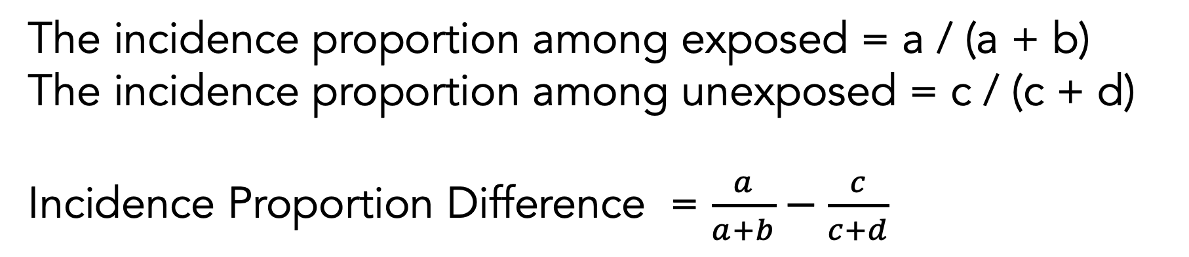
Incidence Proportion Difference
 | Outcome + | Outcome - | Row Total
Exposure + | a | b | a+b
Exposure - | c | d | c+d
Column Total | a+c | a+c | a+b+c+d
The incidence proportion among exposed = a / (a + b)
The incidence proportion among unexposed = c / (c + d)
Incidence Proportion Difference = $\frac{a}{a+b}−\frac{c}{c+d}$

Slide 68
Person
01
02
03
04
 | Disease + | Disease -
Exposure + | 3 | 2
Exposure - | 2 | 2
05
06
07
08
09
10
-01
00
01
02
03
04
05
06
07
08
09
10
11
12
Pre-Follow-Up
Diseased
Month Follow-up
At Risk
Deceased

Slide 69
Source: https://www.r-project.org/logo/

Slide 70
Person
Incidence Proportion Difference
01
02
Among the members of our population, those who were exposed had 0.1 additional cases of disease per person compared to those who were not exposed over the 12 months of follow-up period.
03
04
05
06
07
08
09
10
-01
00
01
02
03
04
05
06
07
08
09
10
11
12
Pre-Follow-Up
Diseased
Month Follow-up
At Risk
Deceased

Slide 71
Incidence Odds Ratio
More commonly called
Odds ratio
Notes:
I like incidence proportion ratio because it is unambiguous and consistent with the previous terminology we have been using.

Slide 72
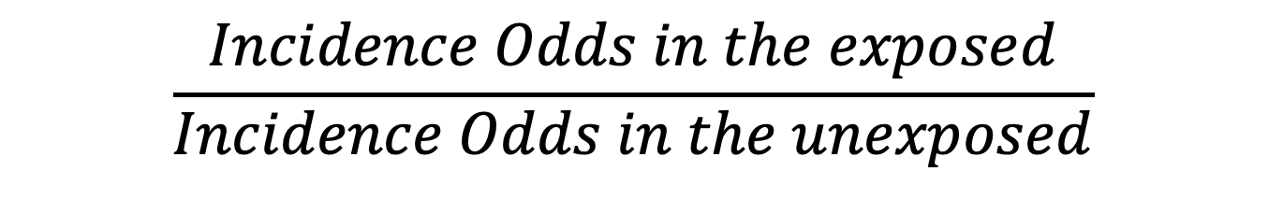
Incidence Odds Ratio
$$\frac{Incidence Odds in the exposed}{Incidence Odds in the unexposed}$$
Notes:
We can write the information from the previous slide in a slightly more mathy way like this.

Slide 73
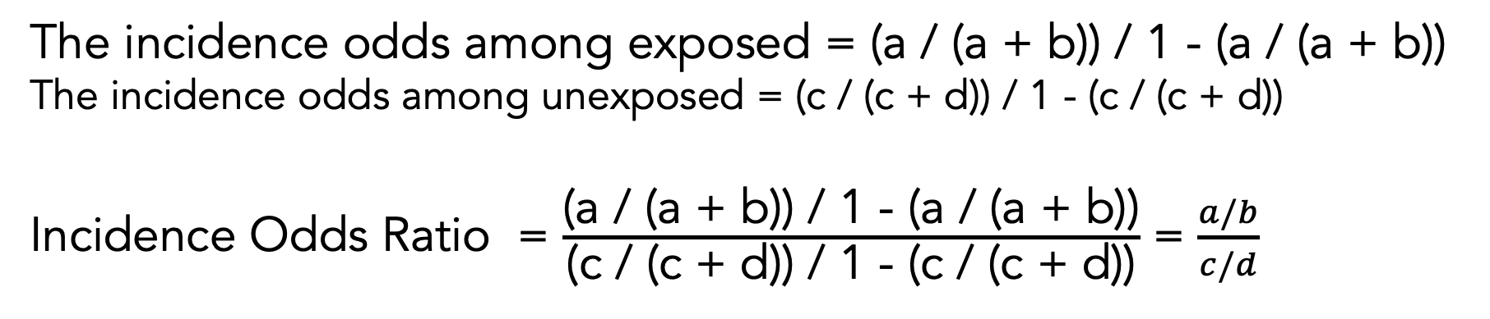
Incidence Odds Ratio
 | Outcome + | Outcome - | Row Total
Exposure + | a | b | a+b
Exposure - | c | d | c+d
Column Total | a+c | a+c | a+b+c+d
The incidence odds among exposed = (a / (a + b)) / 1 - (a / (a + b))
The incidence odds among unexposed = (c / (c + d)) / 1 - (c / (c + d))
Incidence Odds Ratio = $\frac{\text{(}\text{a}\text{ / (}\text{a}\text{ + }\text{b}\text{)) / 1 - (}\text{a}\text{ / (}\text{a}\text{ + }\text{b}\text{))}}{\text{(}\text{c}\text{ / (}\text{c}\text{ + }\text{d}\text{)) / 1 - (}\text{c}\text{ / (}\text{c}\text{ + }\text{d}\text{))}}$ = $\frac{a/b}{c/d}$

Slide 74
Source: https://www.r-project.org/logo/

Slide 75
Person
Incidence Odds Ratio
01
02
Among the members of our population, those who were exposed had 1.5 times the odds of incident disease compared to those who were not exposed over the 12 months of follow-up period.
03
04
05
06
07
08
09
10
-01
00
01
02
03
04
05
06
07
08
09
10
11
12
Pre-Follow-Up
Diseased
Month Follow-up
At Risk
Deceased

Slide 76
Incidence Rate Ratio
More commonly called
Odds ratio
Notes:
I like incidence proportion ratio because it is unambiguous and consistent with the previous terminology we have been using.

Slide 77
Incidence Odds Ratio
$$\frac{Incidence Odds in the exposed}{Incidence Odds in the unexposed}$$
Notes:
We can write the information from the previous slide in a slightly more mathy way like this.

Slide 78
Incidence Odds Ratio
 | Outcome + | Outcome - | Row Total
Exposure + | a | b | a+b
Exposure - | c | d | c+d
Column Total | a+c | a+c | a+b+c+d
The incidence odds among exposed = (a / (a + b)) / 1 - (a / (a + b))
The incidence odds among unexposed = (c / (c + d)) / 1 - (c / (c + d))
Incidence Odds Ratio = $\frac{\text{(}\text{a}\text{ / (}\text{a}\text{ + }\text{b}\text{)) / 1 - (}\text{a}\text{ / (}\text{a}\text{ + }\text{b}\text{))}}{\text{(}\text{c}\text{ / (}\text{c}\text{ + }\text{d}\text{)) / 1 - (}\text{c}\text{ / (}\text{c}\text{ + }\text{d}\text{))}}$ = $\frac{a/b}{c/d}$

Slide 79
Source: https://www.r-project.org/logo/

Slide 80
Person
Incidence Odds Ratio
01
02
Among the members of our population, those who were exposed had 1.5 times the odds of incident disease compared to those who were not exposed over the 12 months of follow-up period.
03
04
05
06
07
08
09
10
-01
00
01
02
03
04
05
06
07
08
09
10
11
12
Pre-Follow-Up
Diseased
Month Follow-up
At Risk
Deceased

Slide 81
Odds
The ratio of the probability of occurrence of an event to that of nonoccurrence, or the ratio of the probability that something is one way to the probability that it is another way. If 60% of smokers develop a chronic cough and 40% do not, the odds among smokers in favor of developing a cough are 60 to 40, or 1.5; this may be contrasted with the probability or risk that smokers will develop a cough, which is 60 over 100 or 0.6. See also LOGIT. (Dictionary of Epidemiology)
Source: Porta, Miquel. A Dictionary of Epidemiology (pp. 8-9). Oxford University Press. Kindle Edition.

Slide 82
Odds ratio
Say the proportion of applicants getting admitted to Cambridge is 𝑝=0.3p=0.3, therefore the odd of getting into Cambridge is 𝑝1−𝑝=0.30.7=0.4286p1−p=0.30.7=0.4286. This number means for every 0.4286 who are admitted there is 1 who are not admitted, or perhaps more clearly for every 4286 who are admitted there are 10000 who are not admitted.
Now we say the proportion of male getting admitted is 0.2 and the proportion of female getting admitted is 0.3, their respective odds will be 0.25 and 0.4286, then the odds ratio for admission of male over female is 0.250.4286=0.58330.250.4286=0.5833. This translates to, if the numbers of applicants for male and female are the same for every 5833 male who are admitted there are 10,000 female who are admitted if the numbers of applicants for both genders are the same.
Notes:
Source: https://www.quora.com/How-do-I-interpret-an-odds-ratio-less-than-1-in-a-logistic-regression

Slide 83


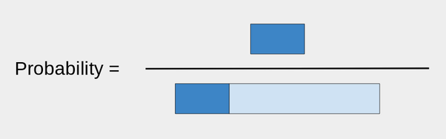
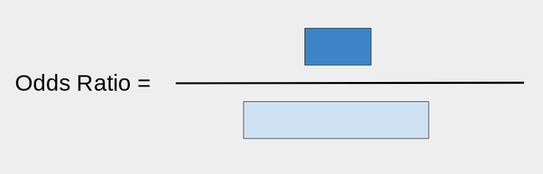
Odds ratio
First take a bar of length 1:
That will be the portion of what did not make it.
Now, take a bar of length r, where r is your ratio. For example, if r was 0.3, I would attach it like so:
The dark blue is the ones that did make it.

Slide 84
OR < 1

Slide 85
Equivalence between exposure OR and disease OR

Slide 86
Add difference between relative and absolute difference example from GPLI presentation

Slide 87
Use Rothman's investment analogy for absolute vs. relative differences
Difference measures such as RD and IRD measure the absolute effect of an exposure. It is also possible to measure the relative effect. As an analogy, consider how to assess the performance of an investment over a period of time. Suppose that an initial investment of $100 became $120 after 1 year. The difference in the value of the investment at the end of the year and the value at the beginning, $20, measures the absolute performance of the investment. The relative performance is obtained by dividing the absolute increase by the initial amount, which gives $20/$100, or 20%. Contrast this investment experience with that of another investment, in which an initial sum of $1000 grew to $1150 after 1 year. For the latter investment, the absolute increment is $150, far greater than the $20 from the first investment, but the relative performance of the second investment is $150/$1000, or 15%, which is worse than the first investment.
Rothman, Kenneth J.. Epidemiology: An Introduction (p. 59). Oxford University Press. Kindle Edition.

Slide 88
Add sensitivity, specificity. Confusion matrix.

Slide 89
Risk difference
“The 5-year risk difference comparing study participants exposed to the contaminant to those who were unexposed was 4%.” (Epi by Design)
for every 1,000 persons who are observed to be exposed to the contaminant (and if those people resemble those we studied), we would expect to likewise observe an additional 40 new cancer cases above the background cancer rate over 5 years. (Epi by Design)
Notes:
Several somewhat technical points about the risk difference measure should be called out here. First, the range of the risk difference is from −1 to +1, inclusive (which we express as [−1, 1]). This is because the highest possible risk is 1, while the lowest is 0; if, as in Table 2.2, the risk in the exposed is higher than in the unexposed, then the risk cannot be higher than 1 − 0 = 1. Similarly, when the risk in the exposed is lower than in the unexposed, then the risk cannot be lower than 0 − 1 = −1. A negative risk difference would occur if the exposure was protective; for instance, if we were considering the association of daily aspirin use with risk of heart attack. Whether the exposure is associated with increased or decreased risk, the risk difference is considered relative to the null value. Again, this is the value which reflects no differences between the two groups being compared. No differences here would mean that the risk in exposed participants and the risk in unexposed participants are the same value P. Therefore, the null for the risk difference is P − P = 0.

Slide 90
Risk Ratio
“The 5-year risk ratio comparing exposed to unexposed study participants is 2.33.” (Epi by Design)
“Over 5 years, we would expect to see 2.33 times the incidence of cancer among exposed study participants compared to unexposed study participants.” (Epi by Design)

Slide 91
Attributable risk in exposed
This might simply be causality applied to risk difference.

Slide 92
Percent attributable risk

Slide 93
Absolute risk reduction

Slide 94
Number needed to treat

Slide 95
Population attributable risk

Slide 96
Point prevalence rate ratio

Slide 97
Multiple testing

Slide 98
Etiologic Fraction
Need to look this up

Slide 99
Effectiveness efficacy
Not sure where to put this…

Slide 100
Matrix
matrices or more generally arrays are multi-dimensional generalizations of vectors. In fact, they are vectors that can be indexed by two or more indices and will be printed in special ways. See Arrays and matrices. (https://cran.r-project.org/doc/manuals/R-intro.html)
As noted above, a matrix is just an array with two subscripts. However it is such an important special case it needs a separate discussion. (https://cran.r-project.org/doc/manuals/R-intro.html#Arrays-and-matrices)
An array can be considered as a multiply subscripted collection of data entries, for example numeric. R allows simple facilities for creating and handling arrays, and in particular the special case of matrices.
A dimension vector is a vector of non-negative integers. If its length is k then the array is k-dimensional, e.g. a matrix is a 2-dimensional array. The dimensions are indexed from one up to the values given in the dimension vector. (https://cran.r-project.org/doc/manuals/R-intro.html#Arrays-and-matrices)

Slide 101

Few checklists
Statistical uncertainty
Causal uncertainty
Uncertainty
Notes:
Last week, we also discussed the importance of uncertainty in epidemiology. One of the three types of uncertainty we discussed was statistical uncertainty.

Slide 102
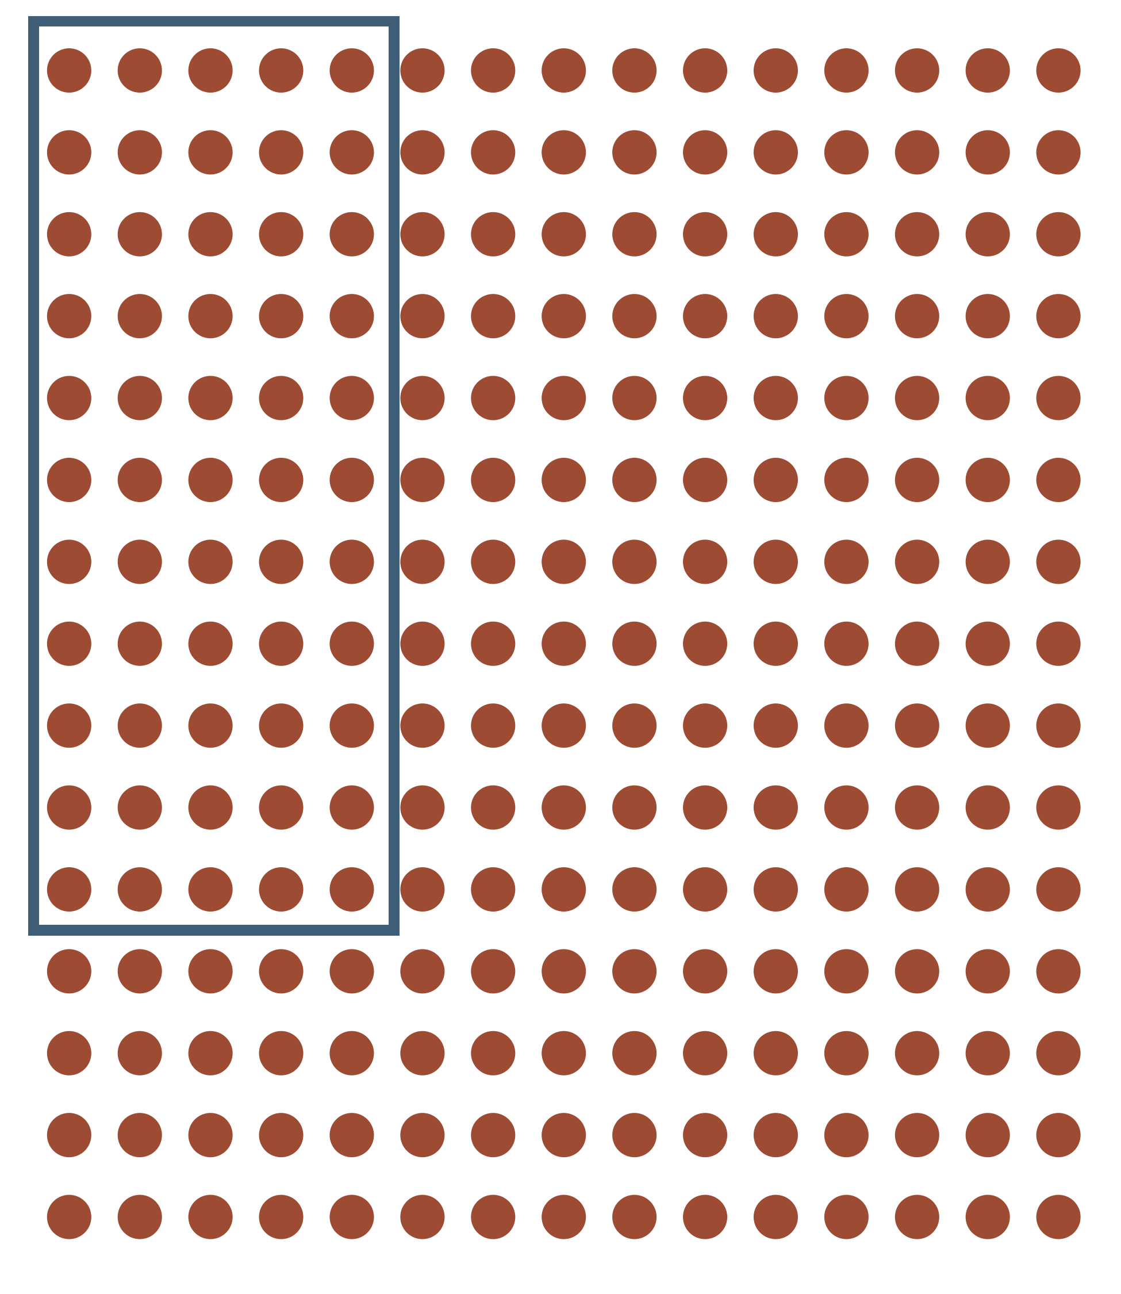
Uncertainty
Notes:
Population vs. sample one of the primary sources of statistical uncertainty.
So, what do we do about that uncertainty? I mean, none of us generally like uncertainty, right? Can we get rid of it? Not usually. Even if we take measure from the entire population, it rarely includes all people who theoretically could be in the population (sometimes called a superpopulation).

Slide 103
Measures of sampling variability
P-values
P-value functions
95% Confidence intervals
Start with that sheet of quotes you sent out as an announcement a couple of semesters ago.

